Slide 1
CULTURAL DIVERSITY WEEK
Stakeholder Pack January 2025
CULTURAL DIVERSITY WE

Slide 2
Acknowledgement of Country | 3
Introduction | 4
Teacher’s resource kit | 5
Help spread the word | 6
Key messaging | 7
How you can participate | 8-10
Creative assets to be shared | 11-17
CDW important observances | 18
Key milestones | 19
Contact | 21
Contents

Slide 3
Acknowledgement of Country
We acknowledge the Traditional Custodians of the land and pay our respects to their Elders, past and present, and extend that respect to all Aboriginal and Torres Strait Islander peoples.
We recognise their continuing connection to land, waters, and culture, and we honour their invaluable contributions to the rich cultural diversity of Victoria.

Slide 4
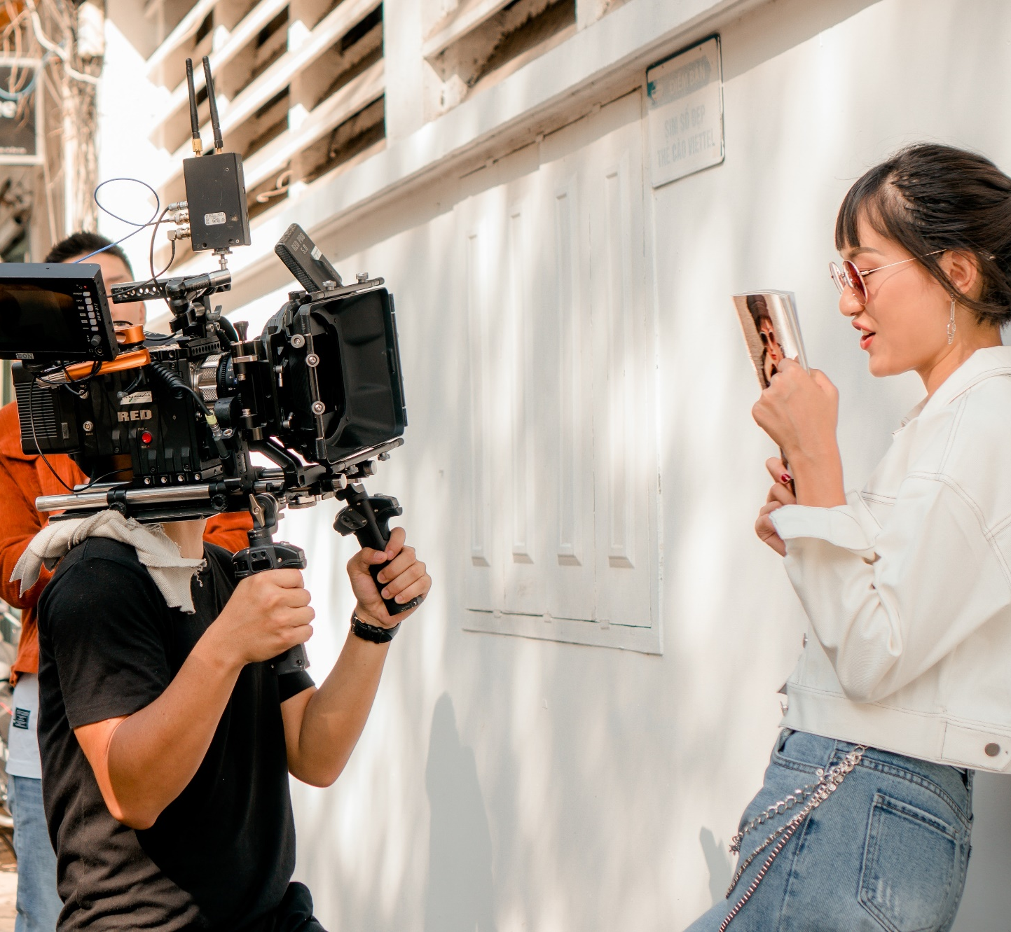
Introduction
Cultural Diversity Week (CDW) is Victoria’s leading multicultural celebration, held annually in March to coincide with the United Nations International Day for the Elimination of Racial Discrimination and Harmony Day on March 21. This week-long initiative showcases the colourful sounds, flavours, sights and traditions of Victoria’s rich and ever-diversifying communities.
Coordinated by the Victorian Multicultural Commission (VMC), Cultural Diversity Week 2025 is dedicated to celebrating the unique journeys and collective stories that define our multicultural identity. This year’s theme, "Embrace the Journey, Shape our Future", invites all Victorians to honour their cultural heritage, share stories of resilience and connection, and explore how culture shapes our present and future.
The week will feature vibrant events, community-led activities, and educational initiatives that foster understanding, inclusion, and respect across the state. By participating, teachers and students can help bring to life the vision of a more connected and cohesive society while celebrating the cultural richness of Victoria’s schools and communities.

Slide 5
Teacher’s resource kit
The Cultural Diversity Week Teacher’s resource kit has been developed to help educators bring this year’s theme, "Embrace the Journey, Shape our Future," to life in the classroom. This resource is designed to support teachers in fostering meaningful discussions, activities, and learning experiences that celebrate Victoria’s rich cultural diversity.
Schools play a critical role in shaping young minds to appreciate and respect different cultures, languages, and traditions. This toolkit provides practical ideas, curriculum-aligned lesson prompts, and engaging activities to encourage students to explore their cultural identity and learn about others.
By using this resource, teachers can facilitate classroom discussions about identity, belonging, and multiculturalism. It includes interactive activities such as storytelling, art, and research projects, as well as guidance on incorporating culturally significant dates observed during Cultural Diversity Week. The toolkit also features age-appropriate lesson plans linked to the Victorian Curriculum, supporting both the Intercultural Capability and Civics and Citizenship learning areas.
Teachers are encouraged to use this resource to engage students in Cultural Diversity Week events, whether through history lessons, creative projects, or school-wide celebrations. The activities in this toolkit aim to inspire curiosity, strengthen connections, and deepen students’ understanding of the diverse communities that shape Victoria.
Access toolkit here

Slide 6
Help spread the word!
Help spread the word about Cultural Diversity Week 2025!
Cultural Diversity Week is a celebration of Victoria’s vibrant multicultural identity, running from Monday 17 March to Sunday 23 March 2025. This year’s theme, "Embrace the Journey, Shape our Future," highlights the unique and collective stories that define our communities and encourages meaningful connections across cultures.
Schools and educators play a key role in amplifying this message and encouraging student engagement. Whether in the classroom, across the school, or in the wider community, there are many ways to take part in Cultural Diversity Week 2025.
You can help to spread the word or become a part of the cultural diversity celebration in the following ways:
HOST AN EVENT/ ACTIVITY
Host a classroom activity, assembly, or cultural showcase to celebrate Cultural Diversity Week. Register your school event on VMConnect, Victoria’s hub for multicultural events.
BE A PART OF THE DIGITAL CAMPAIGN
Amplify student voices and stories. Encourage students to record a short video, photo or narrative, and post it on social media using #CDW2025
ATTEND THE VICTORIAN MULTICULTURAL FESTIVAL
Encourage students to attend, celebrate and unite diverse communities, 21–23 March at the iconic Grazeland, Spotswood

Slide 7
Key messaging
Cultural Diversity Week runs from 17 to 23 March 2025!
Cultural Diversity Week is a time to celebrate the power, influence, and stories of Victoria’s multicultural communities.
All schools, educators, and students are invited to take part through a variety of classroom activities, school events, and digital storytelling initiatives.
This year’s theme, "Embrace the Journey, Shape Our Future," highlights the stories, traditions, and evolving identities that make Victoria a vibrant and inclusive multicultural state.
Proudly led by the Victorian Multicultural Commission, Cultural Diversity Week is an opportunity for schools to foster cultural awareness, encourage meaningful conversations, and celebrate diversity in classrooms and across school communities.
Be part of the celebration! Host a school event, encourage students to join the digital campaign, or organise activities that promote cultural learning.
The Victorian Multicultural Festival is a family friendly festival that will take place at Grazeland from 21–23 March, offering a fantastic opportunity for schools to experience multicultural performances, food, and activities in an exciting festival atmosphere.

Slide 8
How you can participate
You can participate by:
Implementing the teacher resource kit into your curriculum
Sharing the information from this stakeholder pack through school newsletters, social media, and parent communication channels to promote Cultural Diversity Week.
Integrating cultural diversity topics into lessons, discussions, and school-wide activities.
Encouraging students and staff to post about their celebrations using #CDW2025 and #EmbraceTheJourney.
Hosting a cultural dress day, storytelling session, or classroom activity to celebrate diversity.
Supporting Harmony Walks, cultural performances, or community projects that align with the theme of connection and inclusion.
Join our Digital Campaign: Celebrate Cultural Diversity Week 2025 by encouraging students and educators to share their cultural stories through a short video, photo, or written reflection. Post using #CDW2025 and #EmbraceTheJourney to be featured. Click here to learn more and participate!
Resources:
Creative assets available here
Cultural Diversity Week website here
Share your event on VMC Connect here
Utilise hashtags: #CDW2025 #EmbraceTheJourney #ShapeOurFuture
Tag us on Facebook/ Instagram: @multiculturevic
Tag us on LinkedIn: victorian-multicultural-commission

Slide 9
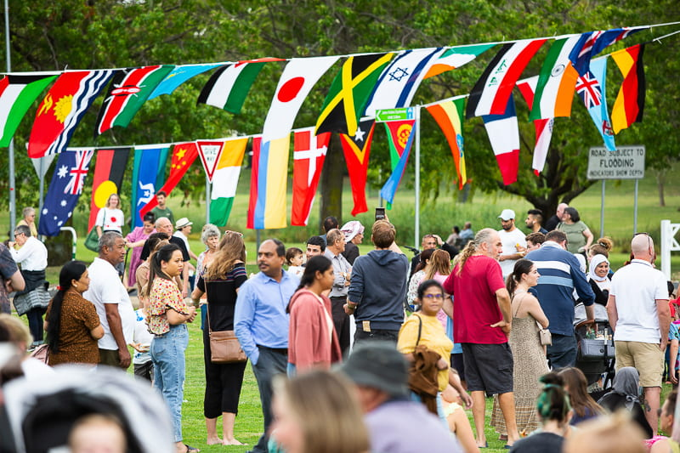
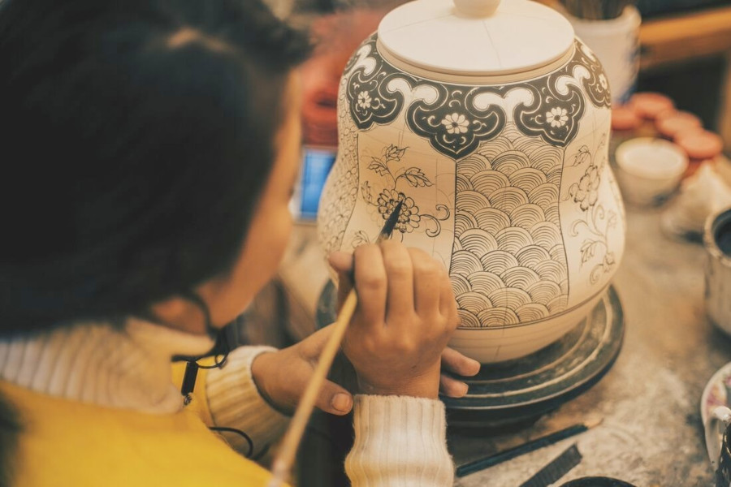
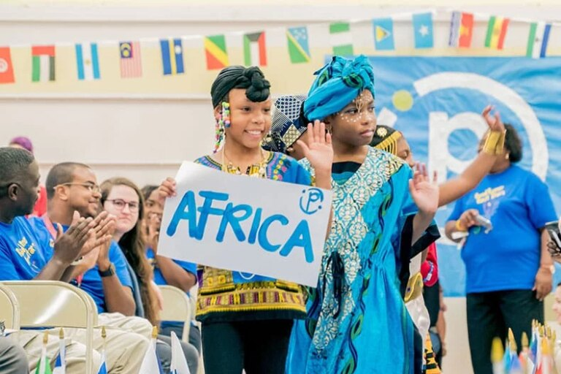
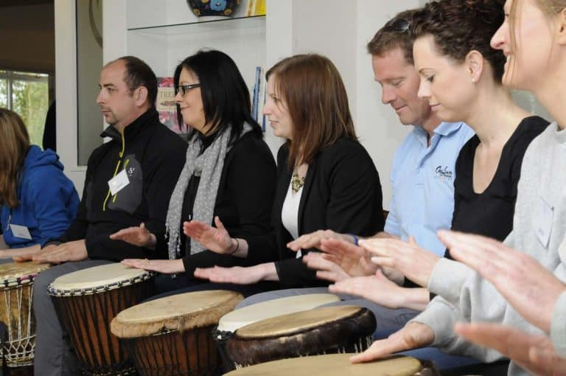
Participate: Host an event or activity in your school
The VMC team encourages schools and educators to take part in Cultural Diversity Week by organising engaging activities that celebrate multiculturalism in the classroom and beyond. Here are some ideas to bring this year’s theme to life:
Embrace the Journey
Cultural Showcase: Encourage students to share stories, traditions, or items from their cultural backgrounds.
Multicultural Food Day: Host a class or school lunch where students bring or learn about traditional dishes from different cultures.
Storytelling Sessions: Read books or invite speakers to share stories that celebrate diversity and identity.
Creative Expression: Organise an art, photography, or writing competition where students explore cultural themes.
Language and Music: Introduce students to different languages through songs, greetings, or interactive activities.
Shape Our Future
Classroom Discussions: Use the VMC’s Cultural Diversity Week Teacher’s Resource Kit to spark conversations on diversity and inclusion.
Exploring Human Rights: Discuss topics such as identity, racism, and belonging using age-appropriate resources.
Harmony Walks: Organise a school walk where students showcase their cultural pride through flags, signs, or traditional clothing.
Film and Media: Watch and discuss short films, documentaries, or student-created content on cultural heritage.
Cultural Dress Day: Celebrate the week with a dress-up day where students and staff wear attire representing their heritage.

Slide 10
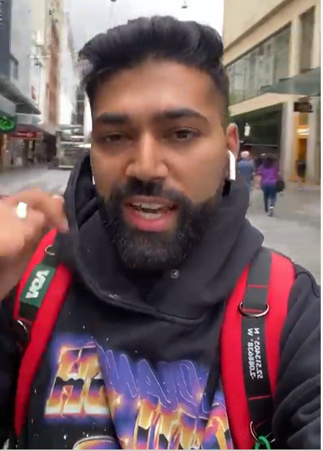
Celebrate: Join our digital campaign
This year’s theme, "Embrace the Journey, Shape our Future", highlights the importance of honouring the diverse cultures that make up Victoria’s vibrant community. We invite you to participate by creating a short video (30–90 seconds) on behalf of your culture to celebrate Cultural Diversity Week and promote the festival. The video can highlight: Your connection to multiculturalism and how it influences your values, your commitment to cultural diversity and why it is important to you or any initiatives or work you’ve done to promote inclusivity in your community.
How Your school can participate:
Keep It short and sweet – Videos should be 30–90 seconds long.
Film in portrait orientation – Ideal for social media platforms.
Introduce your school – Share your name, year level, and school. Example: “Hi, I’m [Name], a Year [X] student at [School]/ a Teacher at [X] school and we’re proud to celebrate Victoria’s diversity.”
Showcase cultural connections – Highlight a tradition, language, or cultural practice that is meaningful to you or your school.
Reflect on diversity – Share why multiculturalism matters in your school and how it strengthens the community.
Make a commitment – Express pride in being part of a multicultural Victoria and your school’s ongoing efforts to embrace diversity.
Tag @VictorianMulticulturalCommission and include the hashtags: #EmbraceTheJourney #CDW2025 #CulturalDiversityWeek #ShapeOurFuture
We encourage schools to get creative! Videos can feature students speaking different languages, classroom discussions on diversity, or cultural performances. The more authentic and engaging, the better! We look forward to seeing how your school embraces this year’s theme and celebrates Victoria’s rich cultural diversity. Please let us know if your school will be participating so we can update our database accordingly.
Please note: If you are using footage of individuals under 18, please ensure you have photo/video consent to cover all bases.
Digital content example:
Click here to watch
Click here to learn more

Slide 11
Suggested social media content:
Cultural Diversity Week
Suggested post copy:
Static social tile
We’re proud to be celebrating Cultural Diversity Week 2025 in schools!
From 17–23 March, students, teachers, and communities across Victoria will celebrate culture, identity, and inclusion through engaging activities and storytelling.
This year’s theme, "Embrace the Journey, Shape Our Future," highlights the power of cultural storytelling, inclusion, and learning in shaping a more connected future.
Be part of the celebration! Host a school event, integrate cultural learning into the classroom, or encourage students to share their cultural stories.
📢 Register your event on VMConnect, Victoria’s online hub for multicultural events: 🔗 https://www.multiculturalcommission.vic.gov.au/cultural-diversity-week-victorian-multicultural-commission
Let’s come together to celebrate, connect, and highlight the cultural diversity in our classrooms and school communities!
#CulturalDiversityWeek #CDW2025 #EmbraceTheJourney #ShapeOurFuture
Click here to download

Slide 12
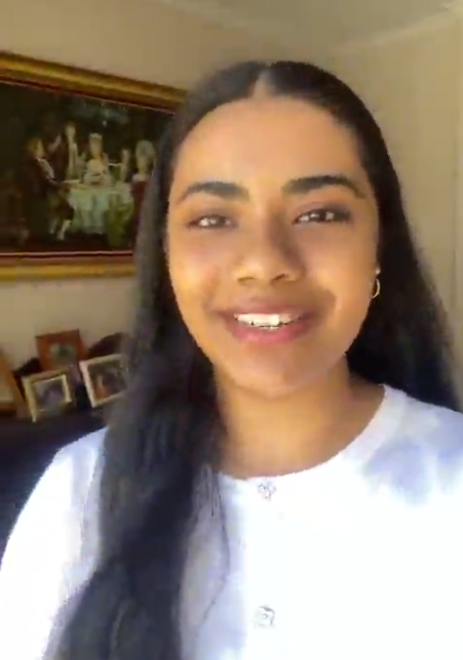
Suggested social media content:
Digital Campaign
Suggested post copy
Digital content example:
Join us in celebrating Cultural Diversity Week by sharing your unique cultural stories!
The Victorian Multicultural Commission invites students to participate by showcasing their favourite traditions, languages or meaningful cultural experiences. Record a short video, capture a photo or write a narrative, then share it on social media using #CDW2025, #EmbraceTheJourney, and #ShapeOurFuture.
Don’t forget to tag @multiculturevic to be featured!
Let’s honour the past, celebrate the present, and shape a multicultural future together.
#CulturalDiversityWeek #CDW2025 #EmbraceTheJourney #ShapeOurFuture
Click here to watch

Slide 13
Suggested social media content:
Victorian Multicultural Festival
Suggested post copy
Static social tile
Animated social story
Join us to celebrate Cultural Diversity Week at the flagship Cultural Diversity Festival 2025!
Taking place from 21–23 March 2025 at the iconic Grazeland in Spotswood, this vibrant festival is the ultimate celebration of Victoria’s multicultural communities, packed with food, entertainment and culture.
🌍 Explore Global Flavours Indulge in an outdoor dining experience featuring cuisine from around the globe – perfect for food lovers!
🎶 Non-Stop Entertainment Enjoy live music, cultural performances and activities for all ages, making it the ideal outing for families and friends.
🎨 Dress for the Occasion Wear your favourite cultural attire or colours and celebrate diversity in style!
🎟️ Event Highlights
$4 entry fee (children under 12 enter free)
Gates open Friday evening and from noon on Saturday and Sunday
Bring your family and friends – we can’t wait to see you there!
Visit the Cultural Diversity Week website for full event details: https://www.multiculturalcommission.vic.gov.au/cultural-diversity-week-victorian-multicultural-commission
#CulturalDiversityFestival #CulturalDiversityWeek #CDW2025 #EmbraceTheJourney #ShapeOurFuture #Grazeland
Click here to download
Click here to download

Slide 14
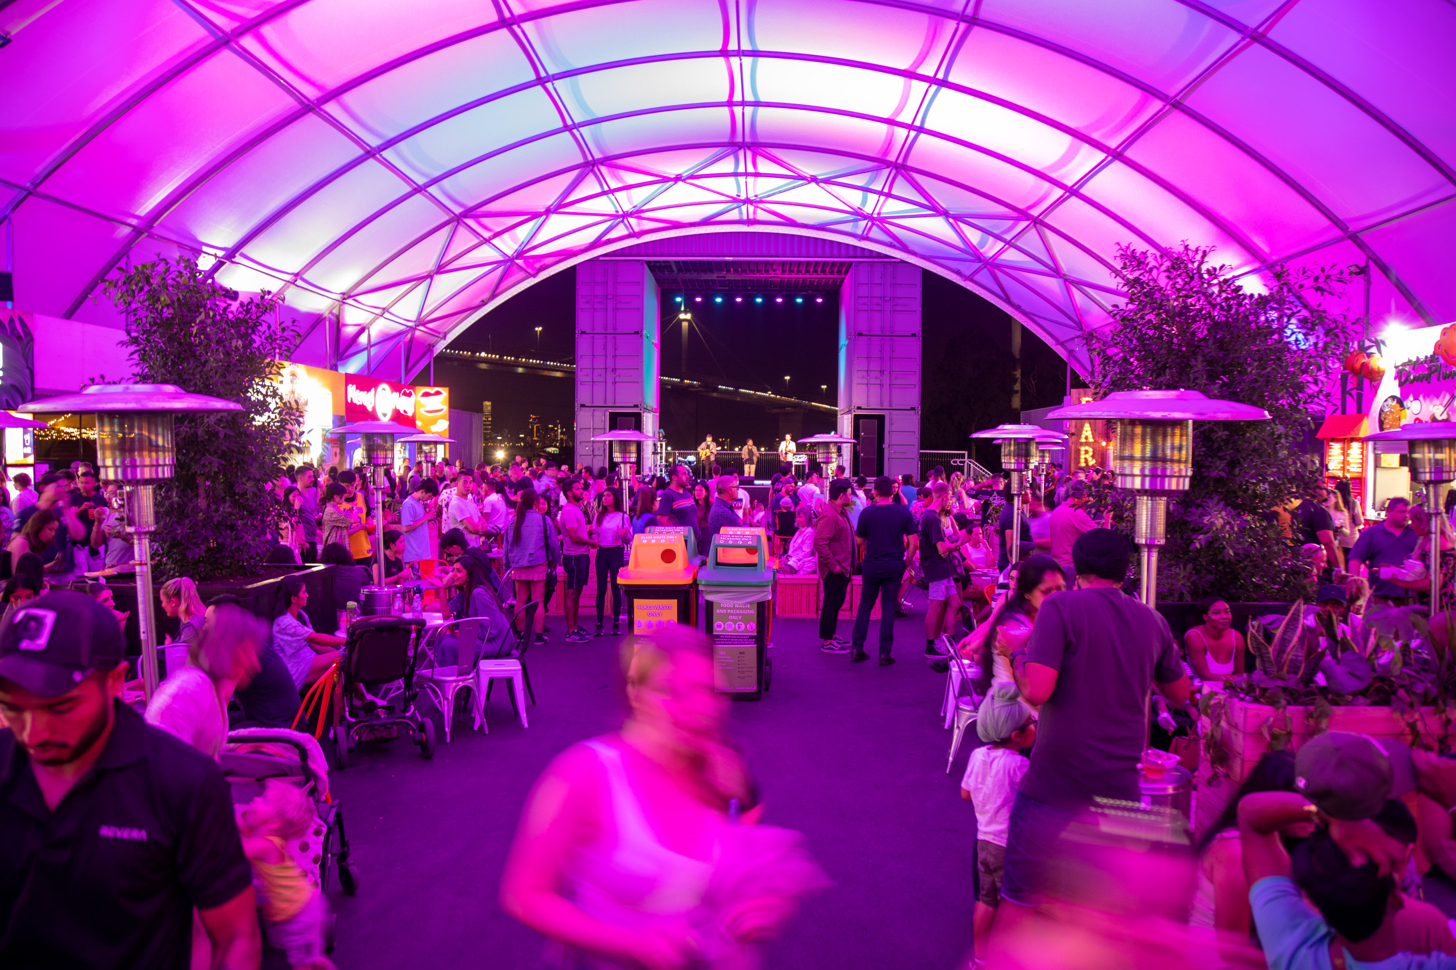
Newsletter header (EDM)
Suggested EDM Content
Get ready for Cultural Diversity Week 2025 — Victoria’s biggest celebration of multiculturalism! From 17–23 March, immerse yourself in a week of vibrant events, inspiring storytelling, and cultural pride as we come together to honour the stories, traditions, and contributions that make Victoria extraordinary.
Whether you're hosting an event, joining the flagship Cultural Diversity Festival, or sharing your cultural story online, there’s a way for everyone to get involved.
🌟 Host or Register an Event Make your community a part of the celebration! Register your event on VMConnect, the online hub for multicultural events in Victoria: Visit the Cultural Diversity Week website for details.
🌟 Be Part of Our Digital Campaign Celebrate this year’s theme, "Embrace the Journey, Shape Our Future," by sharing your unique cultural story. Record a short video, photo, or narrative, and post it on social media using #CDW2025, #EmbraceTheJourney, and #ShapeOurFuture. Don’t forget to tag @multiculturevic to be featured.
🌟 Join the Flagship Event: Cultural Diversity Festival 2025 Taking place from 21–23 March at the iconic Grazeland in Spotswood, this festival is packed with global flavours, vibrant entertainment, and cultural pride:
Indulge in cuisine from around the globe.
Enjoy live music, cultural performances, and family-friendly activities.
Wear your favourite cultural attire or colours and celebrate diversity in style! 🎟️ Entry: $4 (children under 12 free)
Let’s honour the past, celebrate the present, and shape a multicultural future together.
#CulturalDiversityWeek #CDW2025 #EmbraceTheJourney #ShapeOurFuture
Newsletter header

Slide 15
Internal Creative*
*The VMC have developed a Microsoft Teams background and email signature to help you promote Cultural Diversity Week
Teams Creative
Email Signature
Creative assets available here

Slide 16
Social media banners
*The VMC have developed Facebook event banners to help promote your events
Facebook Event Banner
Linked In Banner
Creative assets available here

Slide 17
Promotional poster*
*Please note that posters can be adjusted to be printed in A4 or A3 or can be used as a digital flyer/ screen to promote Cultural Diversity Week
A4/A3 Poster
Creative assets available here

Slide 18
CDW coincides with important observances
Cultural Diversity Week coincides with several important cultural and religious observances, enriching our collective celebration of diversity and inclusion. Here are a few examples:
Ramadan (begins evening of 27 February – ends evening of 30 March 2025) – A sacred month of fasting, prayer, and reflection observed by Muslims worldwide
Holi (Friday, 21 March 2025): A vibrant festival celebrated by the Hindu faith, marking the arrival of spring with colours, music, and joy, bringing communities together worldwide.
Harmony Day (Friday, 21 March 2025): An Australian celebration promoting inclusiveness, respect, and belonging.
Acknowledging and respecting diverse observances:
These important celebrations don't take away from CDW; in fact, they strengthen it.
It's important to acknowledge these significant observances while celebrating CDW.
We encourage stakeholders to consider these dates and ensure their CDW activities are respectful and inclusive of all cultures and faiths.

Slide 19
Key milestones*
*The VMC encourages our partners/stakeholders to promote CDW at key milestones leading to the festival. The VMC will provide updated assets at each milestone.
 | March 2025
MILESTONES | 3 | 10 | 17 | 24 | 31
Entries open for Digital campaign: 1 March 2025
Entries close for digital campaign: 30 March 2025
Entries open for participation (Host event/activity): 17 March 2025
Cultural Diversity Week Begins: 17 March 2025
Victorian Multicultural Festival: 21 to 23 March 2025
Winners announced

Slide 20
Cultural Diversity Week partners and sponsors
Media Partner
Delivery Partner
Major Partner
Event Partner
Promotion Partner
Supporting Partners

Slide 21
Contact
Thank you
For more information, please contact:
communications@vmc.vic.gov.au
Follow us

